Slide 1


INTRODUCTION
Ola Insights Hub: Analytics Dashboard

Slide 2
ABOUT COMPANY
Founded in 2010, Ola is one of India's leading ride-hailing platforms, offering seamless transportation solutions to millions of users.
Global Presence: Operating in multiple countries, including Australia, the UK, and New Zealand, Ola is expanding its footprint in the mobility industry.
Diverse Services: From bike taxis and auto-rickshaws to luxury cars and electric vehicles, Ola caters to various transportation needs and budgets.
Tech-Driven Innovation: Leveraging AI and data analytics, Ola ensures efficient ride-matching, route optimization, and a smooth customer experience.
Sustainability Focus: With its EV initiative, Ola Electric, the company is driving the transition toward eco-friendly mobility solutions.

Slide 3
OBJECTIVE
Comprehensive Performance Monitoring:
To provide actionable insights into booking trends, revenue generation, and ride volumes over time, while analyzing booking status breakdowns to optimize operational efficiency and customer satisfaction.
Optimize vehicle performance :
By analyzing booking success, distance traveled, and overall efficiency to improve service quality and customer satisfaction.
Revenue Tracking and Customer Insights:
The objective is to analyze payment method distribution (Cash, UPI, Credit/Debit Cards), monitor ride distance trends over time, and identify top-performing customers to drive targeted business strategies and enhance revenue generation.
Booking Efficiency and Optimization:
The objective is to analyze and improve the booking process by tracking total bookings, success bookings, and cancellation rates (both by customers and drivers) to identify trends, reduce cancellations, and enhance overall ride availability and customer satisfaction on specific dates.
Enhancing Service Quality and Satisfaction:
The objective is to enhance Ola's service quality by analyzing driver and customer ratings for different vehicle types, ensuring improved satisfaction and performance.

Slide 4
PROBLEM STATEMENTS
Business Requirement
Data Walkthrough
Data cleansing, sorting, filtering, Quality Checking in Power Query, Excel
Creating Database in SQL
Writing SQL Queries to analyze data
Data Connection, Modelling, Processing
Creating Custom Measures & Columns
Perform DAX Calculations & Dashboard Lay outing
Charts Developments and Formatting
Report & Insights Generation

Slide 5
CHART REQUIREMENT
OVERALL DASHBOARD
KPI’s:
Total Bookings - Total number of bookings during the selected period.
Total Revenue - Total income generated in the selected timeframe.
Date - Active date range for the displayed metrics
Booking Status Breakdown:
Objective - To analyze the proportion of different booking status and identify trends or areas requiring improvement.
Chart Type - Pie Chart
Ride Volume Over Time:
Objective - Analyze trends in ride volume over time to identify peak usage periods and pattern
Chart Type – Line Chart

Slide 6
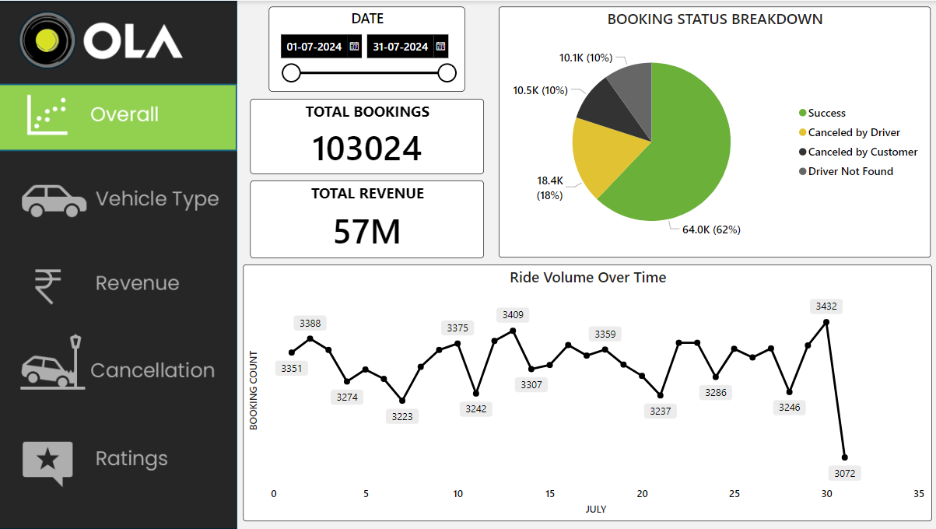
OVERVIEW DASHBOARD

Slide 7
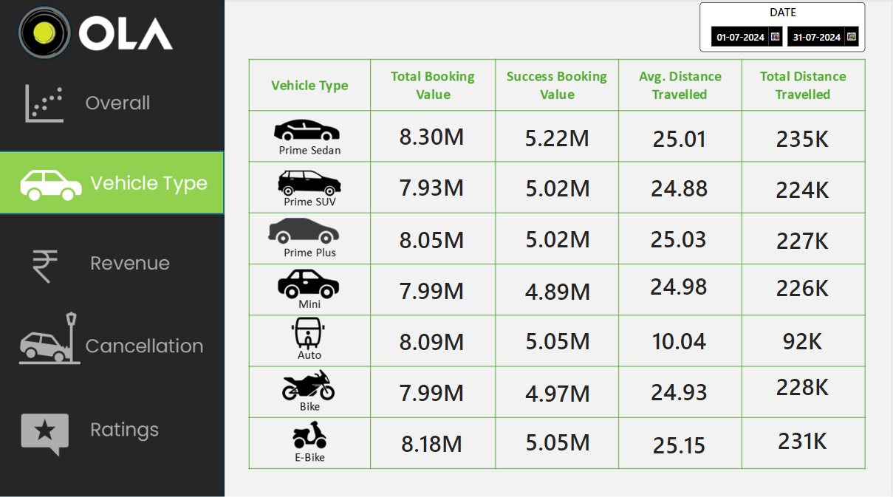
VEHICLE DASHBOARD

Slide 8
CHART REQUIREMENT
REVENUE DASHBOARD
Revenue By Payment Method:
Objective - To compare revenue across payment methods & identify the most preferred option
Chart Type - Stack Column Chart
Ride Distance By Date :
Objective - to track and analyze daily ride distances throughout July 2024, helping identify trends or anomalies in ride activity.
Chart Type - Stack Column Chart
Top 5 Customers :
Objective - To identify the top 5 customers by booking value during the selected period.
Chart Type – Table

Slide 9
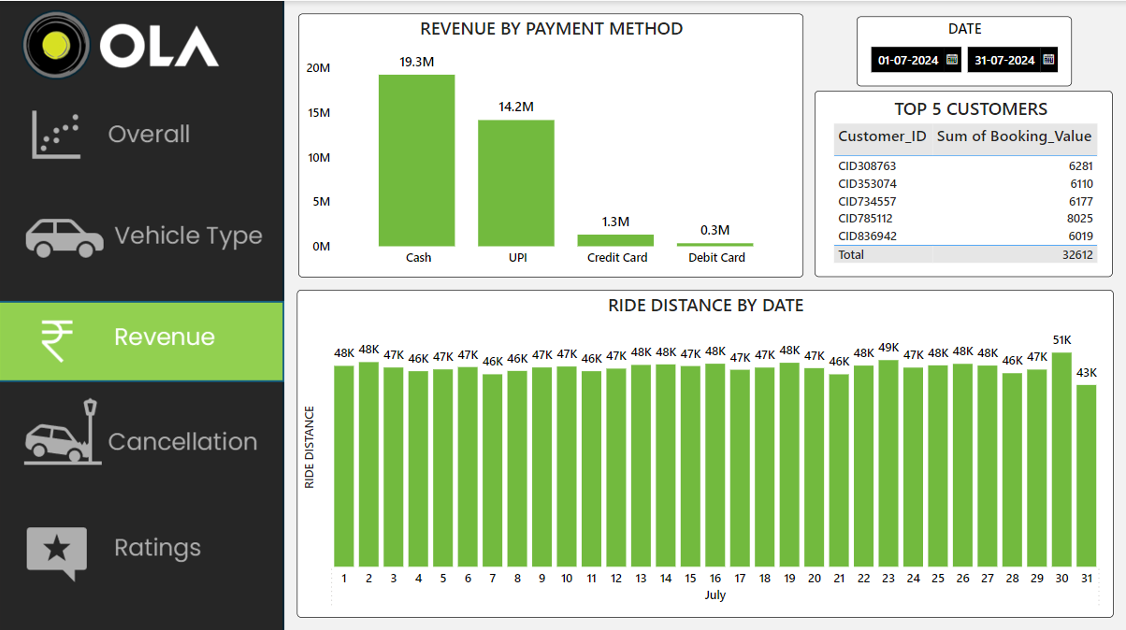
REVENUE DASHBOARD

Slide 10
CHART REQUIREMENT
CANCELLATION DASHBOARD
Cancelled Rides By Customers:
Objective - To analyze reasons behind ride cancellations by customer during selected period.
Chart Type -Pie Chart
Cancelled Rides By Drivers:
Objective - To analyze reasons behind ride cancellations by drivers during selected period.
Chart Type – Pie Chart
KPI’s :
Objective - To track booking performance & analyze cancellation reasons by customers and drivers.
Chart Type – Card

Slide 11
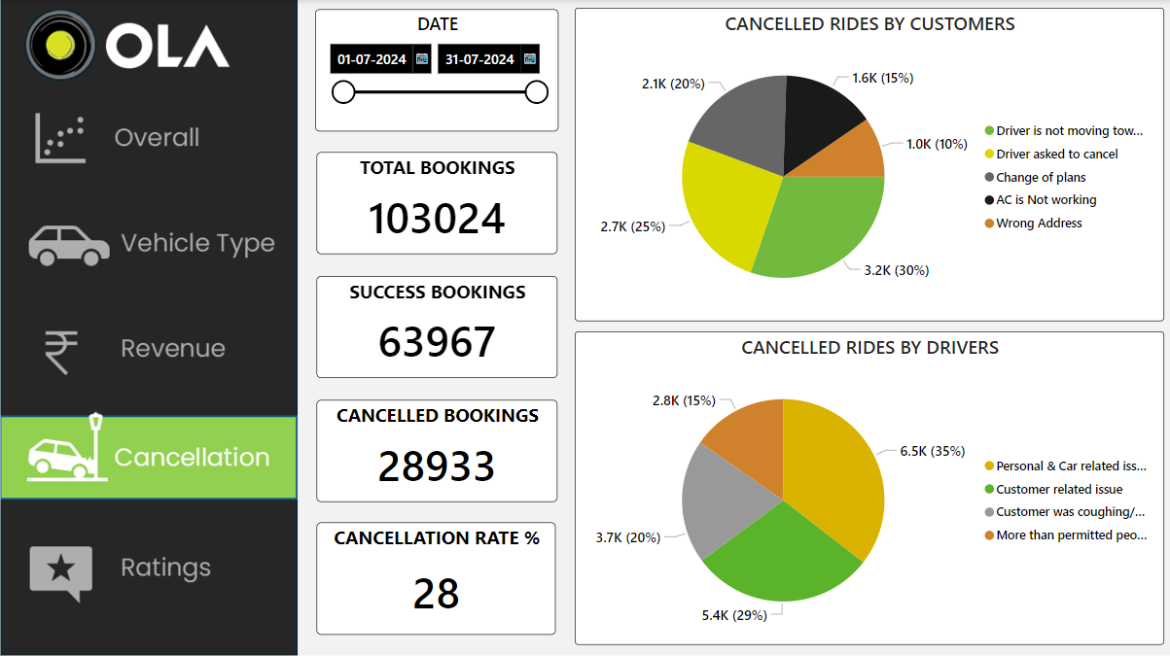
CANCELLATION DASHBOARD

Slide 12
CHART REQUIREMENT
RATING DASHBOARD
Driver’s Rating :
Objective - To evaluate and compare drivers' performance across different vehicle types based on customer ratings.
Chart Type - Card
Customer’s Rating :
Objective - To assess and compare customer behavior and satisfaction across different vehicle types based on driver ratings.
Chart Type - Card
Date :
Objective - To filter and analyze ratings within the selected date range.
Chart Type - Card

Slide 13
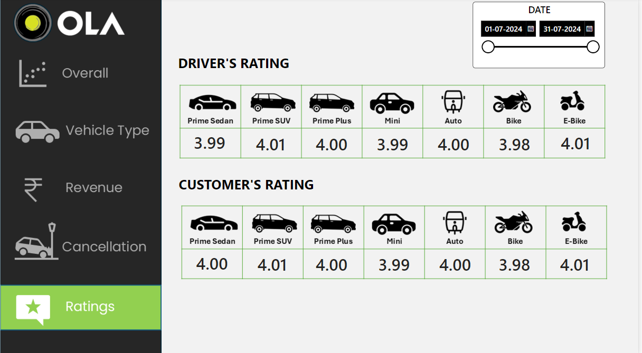
CANCELLATION DASHBOARD

Slide 14
ANALYSIS & FINDINGS
62% of bookings were successful, generating a total revenue of 57M, while cancellations by customers and drivers significantly impacted booking volume trends.
Prime Sedan had the highest total booking value of 8.30M, while E-Bikes had the highest average distance traveled at 25.15 km.
Cash and UPI dominate as payment methods, contributing the highest revenue, while credit and debit card usage remain minimal.
28% of bookings were canceled, with driver-related and customer-related issues being the primary reasons.
Ratings are consistent across vehicle types, with most scores around 4.0 for both drivers and customers.

Slide 15
RECOMMENDATIONS
Focus on reducing cancellations by drivers and customers to improve the success rate and optimize revenue generation.
Promote vehicle types with higher booking success and total distance traveled while addressing factors limiting Auto's average distance performance.
Focus on increasing bookings for high-revenue-generating vehicle types like Prime Sedan and Prime Plus, while addressing the factors causing a drop in bookings for other vehicle types.
Reduce cancellations by addressing the key issues such as customer and driver-related problems, and focus on improving ride confirmations to minimize booking drop-offs.
Maintain or improve customer and driver ratings by focusing on consistency in service quality, particularly for vehicle types with slightly lower ratings, such as bikes and mini vehicles.

Slide 16
THANK YOU

